Slide 1
A DEEP PREDICTION OF CHRONIC KIDNEY DISEASE BY EMPLOYING MACHINE LEARNING METHOD
Guided by :
Presented By:
Mr. K. Saravanan Assistant professor(AI&DS)
S.Rhaxma (810720243027)
J.Abishek Raymond (810720243002)
S.Nandha kumar (810720243022)
C. Tamilvanan (810720243307)

Slide 2
OUTLINE
Abstract
Objective
Background information/Related works
Literature Survey
Existing Method
Existing Method-Disadvantages
Proposed Method
Proposed Method –Advantages
Methodology

Slide 3
ABSTRACT
Chronic kidney disease (CKD) is an important public health issue because CKD patients have an increased risk of end-stage renal disease (ESRD). Dialysis has charged the national health insurance system billions of dollars in recent years, and the costs are rising. We will develop a system by using artificial neural networks, and other data mining algorithms that could predict the disease at early stages.
However , current methods of diagnosis are often invasive ,expensive or inaccurate. Therefore , there is a need for a progressive approach to health management that can predict CKD risk and progression using non-invasive and reliable Biomarkers.By applying this approach to health management , early prediction for CDK detection can be achieved and personalized interventions can be designed for each patient .

Slide 4
OBJECTIVES
The objective of this project is to develop a robust predictive model for early identification of Chronic Kidney Disease (CKD) using pre-processing techniques to clean and optimize the dataset. Through the implementation of three common neural network algorithms coupled with visualization tools for result mapping, the aim is to accurately predict CKD risk, enabling timely provision of healthcare resources to at-risk individuals and potentially preventing adverse health outcomes such as cardiovascular and renal diseases. The objective of this project is to develop a robust predictive model for early identification of Chronic Kidney Disease (CKD) using pre-processing techniques to clean and optimize the dataset. Through the implementation of three common neural network algorithms coupled with visualization tools for result mapping, the aim is to accurately predict CKD risk, enabling timely provision of healthcare resources to at-risk individuals and potentially preventing adverse health outcomes such as cardiovascular and renal diseases.

Slide 5
BACKGROUND INFORMATION
Domain Introduction:
In the healthcare domain, machine learning algorithms play a pivotal role in revolutionizing patient care and disease management. By Leveraging extensive medical data, these algorithms aid in early CKD detection, personalized treatment strategies, and optimizing healthcare resources. From forecasting CKD progression to streamlining dialysis schedules and medication management, machine learning offers a pathway to improved patient outcomes and healthcare system efficiency.
Through the application of neural networks, decision trees, and support vector machines, healthcare providers can harness data-driven insights to deliver timely interventions, ultimately enhancing CKD patient well-being and healthcare delivery.

Slide 6
Problem Statement:
Chronic Kidney Disease (CKD) poses a formidable challenge to healthcare systems globally, marked by difficulties in timely detection and effective management.Despite advancements in medical technology, challenges persist, including inadequate symptom relief, patient attrition, and follow-up irregularities, undermining the efficacy of CKD treatment. To address these hurdles, there's an urgent need for innovative solutions harnessing machine learning to optimize CKD management.

Slide 7
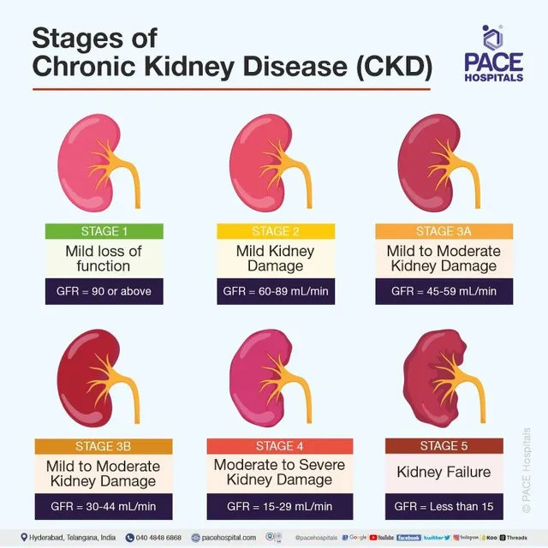
Stages Of CDK:

Slide 9
LITERATURE SURVEY
S.no | Paper Title | Year of Publication | Algorithm Used | Disadvantages

Slide 10
EXISTING METHODS

Slide 11
EXISTING METHODS :DISADVANTAGES

Slide 12
PROPOSED METHODS

Slide 13
PROPOSED METHODS ADVANTAGES

Slide 14
METHODOLOGY

